Slide 1
Basel III- Liquidity Risk Management Reforms
Building a Framework for liquidity crisis
Jawwad Farid
www.alchemya.com
http://financetrainingcourse.com

Slide 2
Game Plan
Anatomy of a Liquidity Crisis
The Basel III – Liquidity adjustments
Framework
Impact and implications
Liquidity
Profitability
Stress Testing

Slide 3
Anatomy of a liquidity crisis

Slide 4
Name Crisis
Change in market conditions
Asset related Loss
Regulatory scandal
Accounting Scandal
Operational Loss

Slide 5
Financial Inst. Business Model
Turnover - Volume
Deposits - Leverage
Equity
Margin
Cost of Funding
Spread and Loan Volumes
Leverage
Return

Slide 6
FI Business Model
Turnover - Volume
Deposits - Leverage
Equity
Margin
Cost of Funding
Spread and Loan Volumes
Leverage
Return
x

Slide 7
Liquidity Crisis
Name Crisis
Asset and share price under pressure
Rating Downgrade
Counterparty Limits Withdrawn or restricted
Margin and Collateral Calls
Liquidity driven Asset Sale

Slide 8
Asset Sales
Name Crisis
Positions disclosed
Anticipated Asset Sales
Asset Sales
Liquidity
Defensive move by market
Aggressive sale by short sellers
Limits Trouble
Margin & Collateral Calls
Restricted trading ability
Net Settlement?

Slide 9
Liquidity Crisis
Name Crisis
Asset and share price under pressure
Rating Downgrade
Counterparty Limits Withdrawn or restricted
Margin and Collateral Calls
Liquidity driven Asset Sale
Short Cut

Slide 10
Cash Generation
Asset Sales
Repurchase agreements
Cash Generation
Secured Term loans
Discount window
Outright sale at depressed prices
Off market settlement for netting off liabilities
Equity Injection
Asset Swap for Cash
Regulatory driven cash injection or take over
Cash conservation
Realignment and restructuring of resources
Discontinued operations
Limit management
Centralization of cash management

Slide 11
BASEL III – Liquidity risk framework

Slide 12
Liquidity Risk Management Principles
In 2008 the Basel Committee on Banking Supervision (BCBS) issued “Principles for Sound Liquidity Risk Management and Supervision”.
This document set out 17 sound principles grouped in 5 areas of focus:
Fundamental principle for the management and supervision of liquidity risk (1)
Governance of liquidity risk management (2-4)
Measurement and management of liquidity risk (5-12)
Public disclosure (13)
The role of supervisors (14-17)

Slide 13
Liquidity Risk Management Principles (cont’d)
Supervisors are expected to assess elements of an institution’s liquidity risk management framework to see if they are in line with these principles. Elements such as:
Board and senior management oversight
Establishment of policies and risk tolerance
Use of liquidity risk management tools such as comprehensive cash flow forecasting, limits and liquidity scenario stress testing
Development of robust and multifaceted contingency funding plans
Maintenance of a sufficient cushion of high quality unencumbered liquid assets to meet liquidity needs

Slide 14
Basel III reforms
In December 2010 BCBS published “Basel III: International Framework for Liquidity Risk Measurement, Standards and Monitoring”
Two global supervisory minimum liquidity risk standards for internationally active banks
Liquidity Coverage Ratio (LCR)
Net Stable Funding Ration (NSFR)
5 liquidity risk monitoring tools
Contractual Maturity Mismatch Profile
Concentration of Funding
Available unencumbered assets
LCR by significant currency
Market Related Monitoring tools

Slide 15
Liquidity Coverage Ratio (LCR)
LCR is a measure of the strength of short term liquidity position of banks. It implies that banks should hold, on a continuous basis, sufficient unencumbered, high quality assets that can easily be converted into cash to meet liquidity needs that could arise during a 30-calendar day period of significantly severe liquidity stress.
LCR = Value of stock of high-quality liquid assets in stressed conditions / Total net cash outflows ≥ 100%
Comes into effect in 2015.

Slide 16
LCR (cont’d)
The stress scenario in general incorporates most of the shocks to liquidity that were experienced during the recent financial and liquidity crisis
The effect of the stress scenario is implemented in the ratio through the application of parameters to various elements of ratio.
Most parameters are prescribed and have been internationally calibrated.
Some are jurisdiction specific and subject to national supervisors’ discretion
National supervisors may subject individual banks to stricter standard requirements or parameters based on their assessment of a bank’s liquidity risk management against the “Principles of sound liquidity risk management”.

Slide 17
LCR Numerator: High Quality Liquid Assets
Assets which remain liquid during times of extreme stress and which ideally are central bank eligible for intraday and overnight liquidity needs
In general asset liquidity is impacted by three primary factors:
Stress scenario assumed
Volume of asset monetized
Time frame for which liquidity needs are being assessed

Slide 18
LCR Numerator (cont’d)
Fundamental & market-related characteristics of liquid assets:
Low level of riskiness,
Priced easily and with a degree of certainty,
Low correlation with risky assets,
Listed on a recognized exchange
Size and activity of their markets
Diversity of buyers and sellers in the market
Number of market makers present
Whether the market chooses to remain/ enter in them during a liquidity crisis

Slide 19
LCR Numerator (cont’d)
Operational requirements of liquid assets
Unencumbered
Separate from other assets (hedges, collateral, credit enhancements, etc)
managed and controlled by a separate function in the bank
a proportion of them are periodically sold on the repo market or outright
Must be maintained in each currency that bank operates in.
If becomes ineligible bank can continue to hold the asset for an additional 30-calendar day period so as to allow for an orderly adjustment of the liquid asset portfolio as well as sale of the previously eligible liquid asset.

Slide 20
LCR Numerator (cont’d)
For calculation purposes these assets are categorized as Level 1 assets and Level 2 assets
Examples of Level 1 assets
cash;
qualifying central bank reserves;
qualifying marketable securities from sovereigns, central banks, PSEs and multilateral development banks;
domestic sovereign or central bank debt in domestic currency;
domestic sovereign debt in foreign currency.

Slide 21
LCR Numerator (cont’d)
Treatment of Level 1 assets in ratio:
No limitation as to how much of these assets can be held within the stock of liquid assets
Held at market value
Not subject to any haircut, i.e. 100% of their value may be considered in the calculation of LCR.
National supervisors have the discretion to require their banks to assess a haircut for these assets based on the duration, credit or liquidity risk, etc.

Slide 22
LCR Numerator (cont’d)
Examples of Level 2 assets:
sovereign, central bank, and PSE assets that would qualify for a 20% risk weight under the Basel II Standardized Approach;
qualifying corporate and covered bonds rated AA- or higher.
Treatment of Level 2 assets in ratio:
40% cap (after haircuts) on the amount of Level 2 assets that can be held within the stock of liquid assets
Must be well diversified
Minimum haircut of 15% applicable on the market value of the assets. Higher haircuts may be assessed.

Slide 23
LCR Numerator (cont’d)
Additional condition that Level 2 assets must satisfy
Maximum value of Adjusted Level 2 assets (after haircuts) = 2/3 * Adjusted Level 1 assets (after haircuts)
Adjustment for unwinding of those assets that can be exchanged for non-Level 1 and 2 assets in the course of carrying out transactions for short term (<=30 days) secured funding, secured lending and collateral swaps.

Slide 24
LCR Denominator: Total net cash outflows
Total net cash outflows = Total expected cash outflows less Total expected cash inflows
Total expected cash outflows => sum of: Outstanding Liability Balances or off-balance sheet committments × Expected Run-off/ Draw down rates
Total expected cash inflows => sum of: Outstanding balances of contractual receivables × Expected Inflow rates
The total expected cash inflows are subject to a maximum value equal to 75% of the total expected cash outflows.
The expected run-off and inflow rates are influenced by the stress scenario assumed in the calculation of the ratio.

Slide 25
LCR Denominator (cont’d)
As mentioned earlier most of rates or parameters are prescribed and calibrated to ensure international harmonization.
Some rates will be set according to national supervisors’ discretion
Higher/ lower minimums for run-off/ inflow rates or additional categories together with their run-off/ inflow rates may be developed by national supervisors for banks operating in their jurisdictions.
Assets used as high quality liquid assets cannot be double counted as assets producing the cash inflows
Cash outflows, if applicable to a number of cash outflow categories, are limited to the maximum amount that can be contractually paid out.

Slide 26
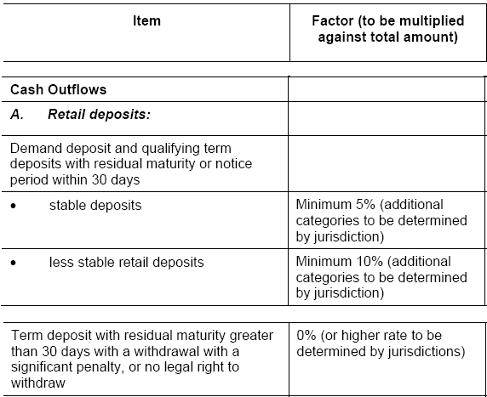
LCR Denominator- Cash Outflows

Slide 27
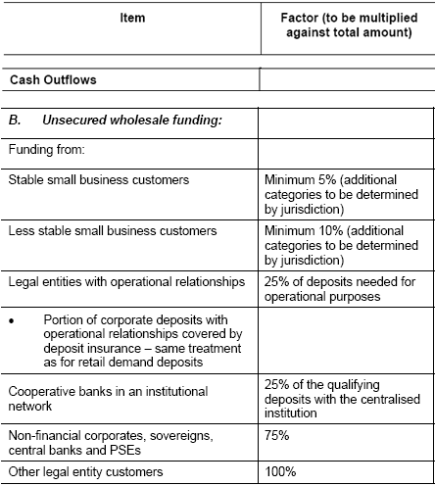
LCR Denominator – Cash Outflows(cont’d)

Slide 28
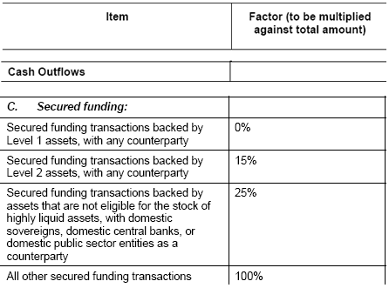
LCR Denominator- Cash Outflows (cont’d)

Slide 29
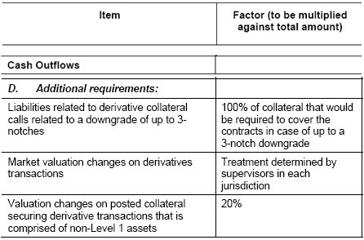
LCR Denominator- Cash Outflows (cont’d)

Slide 30
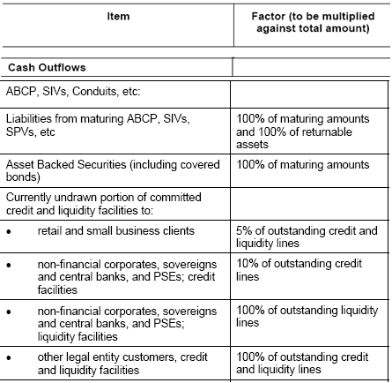
LCR Denominator- Cash Outflows (cont’d)

Slide 31
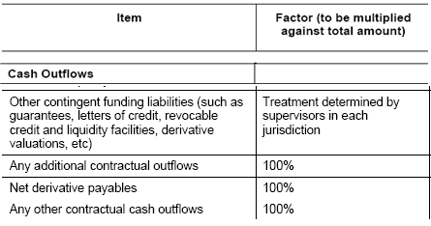
LCR Denominator- Cash Outflows (cont’d)

Slide 32
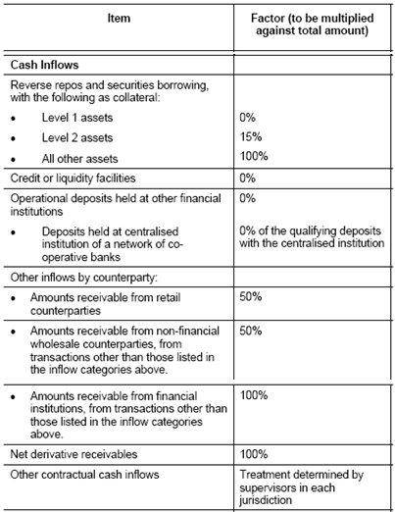
LCR Denominator- Cash Inflows

Slide 33
Net Stable Funding Ratio (NSFR)
Available amount of Stable Funding/Required amount of Stable funding ≥ 100%
Measure of bank’s longer term liquidity risk profile.
Covers a horizon of 1 year, under conditions of extended firm-specific stress,
Aims to capture short term structural mismatches in liquidity so as to discourage bank’s over-reliance on funding long term assets with short term liabilities and to move the focus to longer term liquidity funding sources.
Comes into effect in 2018.
Firm specific stress scenarios:
significant decline in the bank’s profitability,
potential ratings downgrade
a reputational risk event.

Slide 34
NSFR Numerator: Available Amount of Stable Funding (ASF)
Calculated as weighted sum of the carrying values of each ASF component where the weights are ASF factors assigned to each component category.

Slide 35
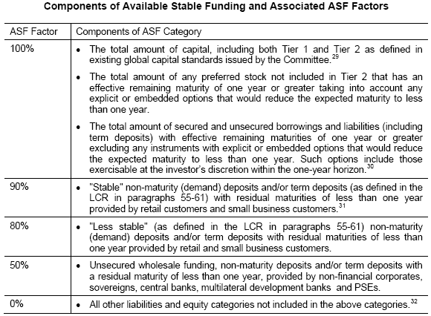
NSFR Numerator (cont’d)

Slide 36
NSFR Denominator: Required Amount of Stable Funding (RSF)
Calculated as weighted sum of the value of assets held and funded by the entity including off-balance sheet exposures where the weights are RSF factors assigned to each RSF asset category.
weights represent portion of asset that cannot be monetized either by sale or use as collateral in an extended firm-specific liquidity stress scenario- assets
More liquid assets will be assigned lower RSF factors

Slide 37
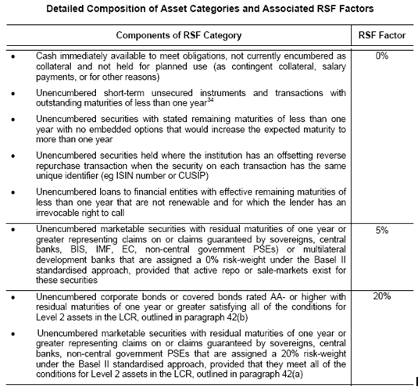
NSFR Denominator (cont’d)

Slide 38
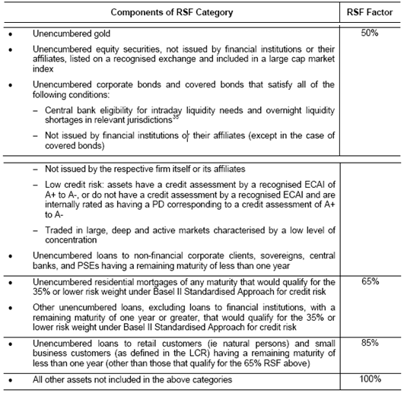
NSFR Denominator (cont’d)

Slide 39
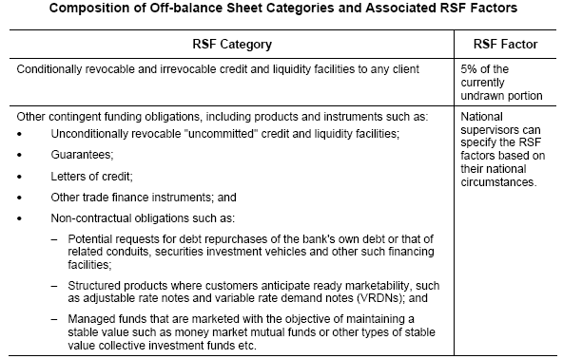
NSFR Denominator (cont’d)

Slide 40
Liquidity Standards- Observation Period
Both ratios will be subject to an observation period prior to their implementation deadlines during which time their calibration and designs will be monitored and assessed to ensure that there are no unintended consequences to the banking sector and financial system because of their introduction.

Slide 41
Monitoring Tools
5 metrics to monitor bank’s liquidity position on a consistent basis.
National supervisory authorities can suggest additional measures to monitor liquidity as well as act as early warning indicators

Slide 42
Monitoring Tools (cont’d)
Contractual maturity mismatch
This identifies the gaps between the contractual inflows and outflows for defined time bands.

Slide 43
Monitoring Tools (cont’d)
Concentration of funding
Identifies wholesale funding sources of such significance that withdrawal could trigger liquidity problems.
Encourages diversification of funding sources
Significant funding sources, by counterparty or product have value > 1% of Bank’s total balance sheet,
Significant funding sources by currency, aggregate liabilities > 5% of the bank’s total liabilities.

Slide 44
Monitoring Tools (cont’d)
Concentration of funding (cont’d)
Specific metrics are calculated as follows:
By counterparty: Funding Liabilities sourced from each significant counterparty/Balance Sheet Total
By product: Funding Liabilities sourced from each significant product/Balance Sheet Total
By currency: Asset and Liabilities amounts by significant currency

Slide 45
Monitoring Tools (cont’d)
Available unencumbered assets
This is a report of the amount, currency, type and location of, and estimated haircuts applicable to, available unencumbered assets which can be used as collateral in the secondary markets and/ or are central bank eligible.
LCR by significant currency
This metric allows banks and supervisors to track potential currency mismatches under a stress scenario.
Value of stock of high-quality liquid assets in each significant currency/Total net cash outflow over the next 30-day period in each significant currency

Slide 46
Monitoring Tools (cont’d)
Market-related monitoring tools
Use of high frequency market data, having little or no time lag, to identify signs of potential liquidity stress.
Monitored at the following levels:
Market-wide (equity prices, debt, FX & commodities markets, product indices)
Financial sector (equity prices, debt markets, product indices)
Bank-specific (equity prices, credit spreads, money-market trading prices, rollovers and prices by funding length, yield on bank-issued debt)

Slide 47
Application and Scope
Frequency of Calculation and Reporting Metrics should be used on an ongoing basis to help monitor and control liquidity risk. Banks are expected to meet the requirements of the standards continuously, report the metrics at least monthly within a two-week time lag.
Scope of Application For all internationally active banks on a consolidated basis.
may be used for other banks to ensure greater consistency and a level playing field between domestic and cross-border banks.
Currencies
While the standards are expected to be met on a consolidated basis and reported in a common currency, supervisors and banks should also be aware of the liquidity needs in each significant currency.

Slide 48
Conclusion
Impact and implications
Liquidity
Profitability
Stress Testing
Core Lending

Slide 49
Jawwad Farid jawwad@alchemya.com www.alchemya.com http://financetrainingcourse.com

